Slide 1
Computer Vision – Module 3
Dr. Sreejith Rajan

Slide 2
Interpolation
Interpolation methods estimate unknown pixel values when an image is resized, rotated, or geometrically transformed. During such transformations, the mapped pixel location often falls at non-integer coordinates, so interpolation is used to calculate the pixel intensity at that location.
The three commonly used interpolation techniques are:
Nearest Neighbour Interpolation
Bilinear Interpolation
Bicubic Interpolation

Slide 3
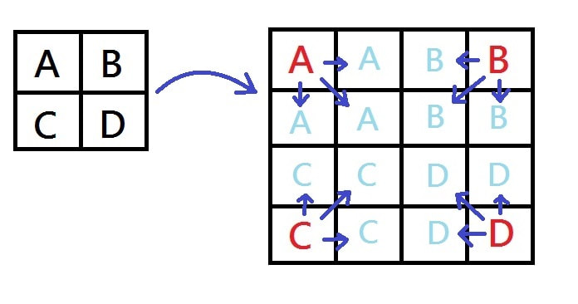
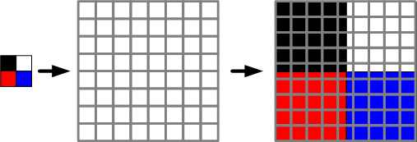
Nearest Neighbour Interpolation
Nearest neighbour interpolation is the simplest interpolation technique in which the value of the nearest pixel to the calculated coordinate is assigned to the new pixel.
It does not compute new pixel values, but simply copies the value of the closest existing pixel.

Slide 4

Mathematical representation
If the mapped coordinate is (x, y):
$$f\left(x , y\right)=f\left(r , ound\left(x\right)round\left(y\right)\right)$$
Where
$f\left(x , y\right)$= interpolated pixel value
$round\left(x\right),round\left(y\right)$= nearest integer coordinates.

Slide 5
Working Principle
Perform the geometric transformation (scaling/rotation).
Compute the mapped coordinate.
Find the closest integer pixel position.
Copy that pixel value to the new location
Advantages
Very simple algorithm
Fastest interpolation method
Requires very low computation
Disadvantages
Produces blocky or jagged edges
Poor image quality when enlarging images
Not suitable for high-quality image scaling

Slide 6
Applications
Fast image preview
Real-time systems
Binary images or label maps

Slide 7
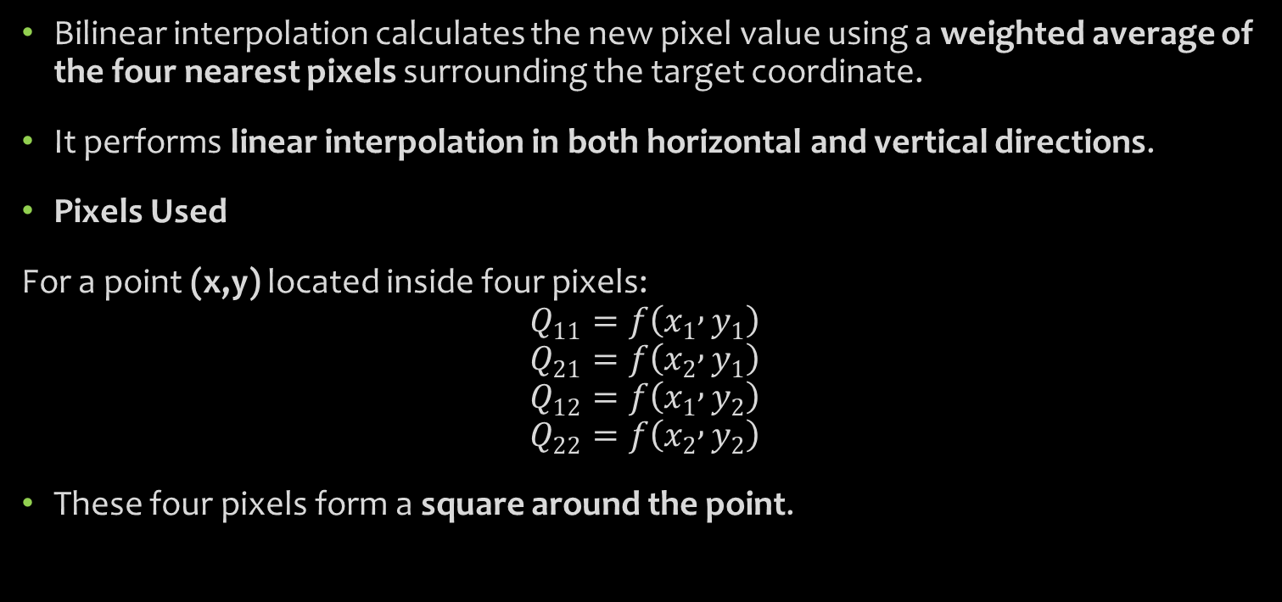
Bilinear Interpolation
Bilinear interpolation calculates the new pixel value using a weighted average of the four nearest pixels surrounding the target coordinate.
It performs linear interpolation in both horizontal and vertical directions.
Pixels Used
For a point (x,y) located inside four pixels:
$$Q_{11}=f\left(x_{1} , y_{1}\right)$$
$$Q_{21}=f\left(x_{2} , y_{1}\right)$$
$$Q_{12}=f\left(x_{1} , y_{2}\right)$$
$$Q_{22}=f\left(x_{2} , y_{2}\right)$$
These four pixels form a square around the point.

Slide 8
Working Principle
Locate the four surrounding pixels.
Perform linear interpolation along x direction.
Perform linear interpolation along y direction.
Calculate the weighted average.

Slide 9
Characteristics
Advantages
Produces smoother images than nearest neighbour
Simple mathematical model
Moderate computational complexity
Disadvantages
Causes slight blurring
Edges may become less sharp

Slide 10
Applications
Image scaling
Texture mapping
Computer graphics
Real-time rendering

Slide 11
Bicubic Interpolation
Bicubic interpolation calculates the pixel value using 16 neighbouring pixels (4×4 grid) around the target point.
It performs cubic interpolation along both horizontal and vertical directions.

Slide 12
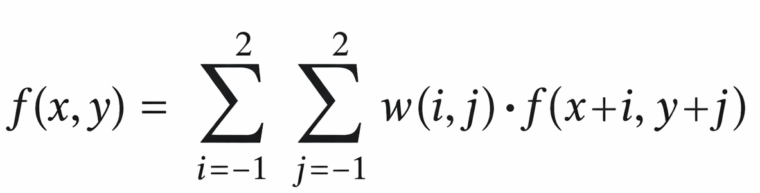

Mathematical representation
The interpolated value is obtained using a weighted sum:
Where
$f\left(x , +iy+j\right)$= neighbouring pixel values
$w\left(i , j\right)$= cubic weight function.

Slide 13
Working Principle
Identify the 16 surrounding pixels.
Apply cubic interpolation horizontally.
Apply cubic interpolation vertically.
Compute weighted average.

Slide 14
Advantages
Produces very smooth images
Better edge preservation
Higher visual quality
Widely used in professional image processing
Disadvantages
High computational complexity
Slower than bilinear interpolation

Slide 15
Applications
Image editing software
Medical imaging
Satellite image processing
High-quality image resizing

Slide 16
Comparison
Method | Pixels Used | Complexity | Image Quality
Nearest Neighbour | 1 | Very Low | Poor
Bilinear | 4 | Medium | Moderate
Bicubic | 16 | High | High

Slide 17
Key Differences
Feature | Nearest | Bilinear | Bicubic
Order | Zero order | First order | Third order
Smoothness | Low | Medium | High
Computation | Very fast | Moderate | Slow
Quality | Blocky | Slight blur | Smooth

Slide 18
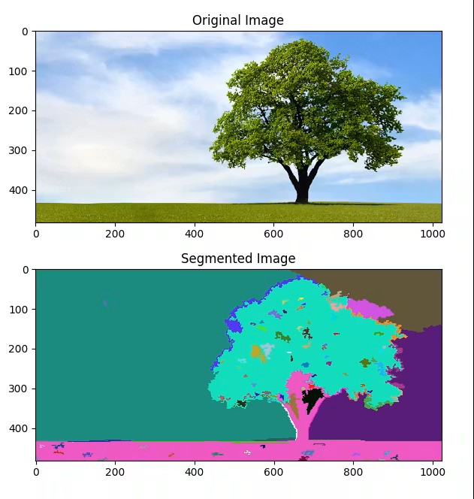
Image Segmentation
Image segmentation is the process of dividing an image into multiple meaningful regions or objects so that each region represents a specific part of the image.
The goal is to simplify the image representation and make it easier to analyze.
In segmentation, pixels with similar properties (such as intensity, color, or texture) are grouped together.

Slide 19

Mathematical Representation
If an image $I$ is divided into $n$ regions:
$$I=R_{1}∪R_{2}∪R_{3}∪...∪R_{n}$$
Where
$R_{i}$= segmented region
$R_{i}∩R_{j}=∅$ for $i≠j$
This means the regions do not overlap and together form the complete image.

Slide 20
Thresholding
Thresholding is one of the simplest and most important segmentation techniques in image processing.
It separates an image into foreground and background based on pixel intensity values.
If a pixel value satisfies a condition relative to a threshold value (T), it is classified as object; otherwise background.
Thresholding converts a grayscale image into a binary image by comparing each pixel with a threshold value.

Slide 21
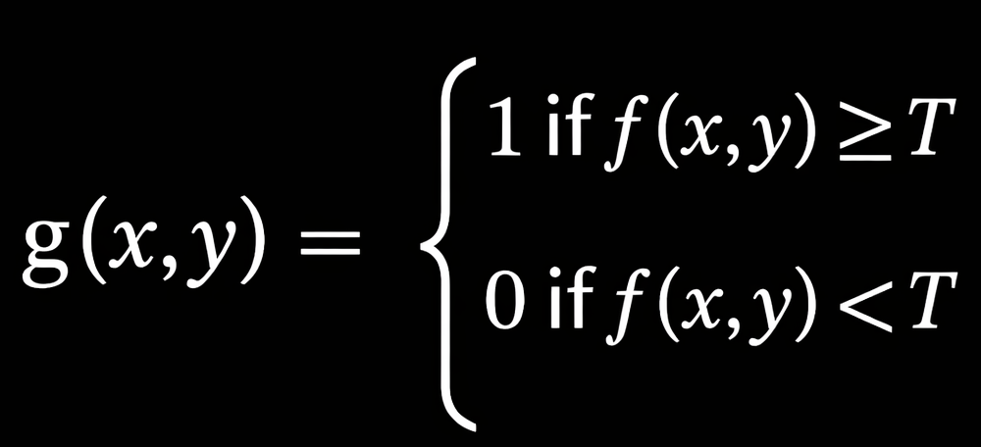

Mathematical Representation
Where
$f\left(x , y\right)$= original image
$g\left(x , y\right)$= thresholded binary image
$T$= threshold value

Slide 22
Working Principle
Choose a threshold value T.
Compare each pixel value with T.
Assign
1 (white) → object
0 (black) → background.
Applications
Document image processing
Object detection
Medical image segmentation
Industrial inspection

Slide 23
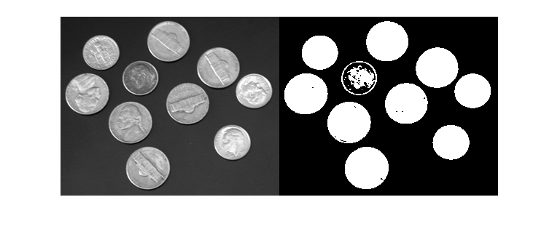
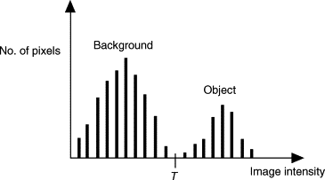

Global Thresholding
Global thresholding uses a single threshold value for the entire image.
$g\left(x , y\right)=\left\{\begin{matrix}1 & f\left(x , y\right)≥T \\ 0 & f\left(x , y\right)<T\end{matrix}\right.$
The threshold value T remains constant across the whole image.

Slide 24
Steps
Compute histogram of image intensities.
Select a threshold value T.
Apply the same threshold to all pixels.
Advantages
Simple implementation
Fast computation
Disadvantages
Not suitable for images with non-uniform illumination
Sensitive to lighting variations

Slide 25
Automatic Threshold selection
Automatic threshold selection determines the optimal threshold value automatically using statistical properties of the image.
The most common method is Otsu's method.
Otsu's Method Principle
Otsu’s algorithm selects a threshold that maximizes the variance between two classes:
Foreground
Background
It assumes the histogram has two peaks (bimodal distribution).

Slide 26
Steps
Compute the histogram.
Divide pixels into two classes using threshold T.
Compute between-class variance.
Select T that maximizes variance.
Advantages
Fully automatic
Good for bimodal histograms
Widely used in practice

Slide 27
Dynamic Thresholding (Adaptive Thresholding)
Dynamic thresholding uses different threshold values for different regions of the image.
It is also called:
Adaptive Thresholding or Local Thresholding.

Slide 28

Mathematical representation
Mathematical Representation
$$g\left(x , y\right)=\left\{\begin{matrix}1 & f\left(x , y\right)≥T\left(x , y\right) \\ 0 & f\left(x , y\right)<T\left(x , y\right)\end{matrix}\right.$$
Where
$T\left(x , y\right)$= local threshold depending on neighborhood.

Slide 29

Working Principle
Mathematical Representation
$$g\left(x , y\right)=\left\{\begin{matrix}1 & f\left(x , y\right)≥T\left(x , y\right) \\ 0 & f\left(x , y\right)<T\left(x , y\right)\end{matrix}\right.$$
Where
$T\left(x , y\right)$= local threshold depending on neighborhood.

Slide 30
Advantages
Works well for uneven illumination
Better segmentation in complex images
Disadvantages
Higher computational cost
More complex implementation

Slide 31
Comparison
Method | Threshold Value | Suitable For
Thresholding | Fixed value | Simple images
Global Thresholding | One value for whole image | Uniform illumination
Automatic Threshold | Computed automatically | General images
Dynamic Thresholding | Local threshold values | Uneven lighting

